Slide 1

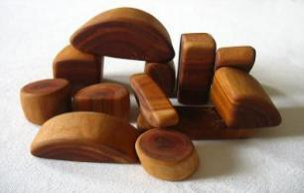
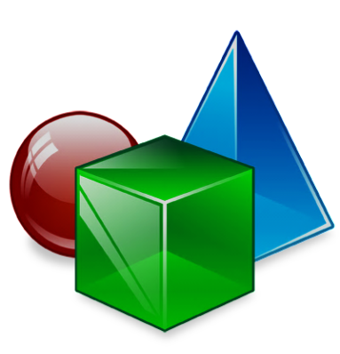
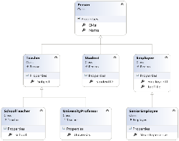

Object-Oriented Programming Fundamental Principles – Part II
Polymorphism, Class Hierarchies, Exceptions, Strong Cohesion and Loose Coupling
Object-Oriented

Slide 2


Contents
Polymorphism
Class Hierarchies: Real World Example
Exception Handling and Exception Classes
Cohesion and Coupling

Slide 3
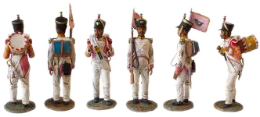
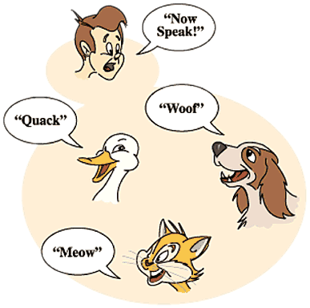
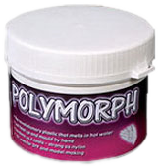
Polymorphism
Notes:
(c) 2006 National Academy for Software Development - http://academy.devbg.org*
3##

Slide 4
Polymorphism
Polymorphism = ability to take more than one form (objects have more than one type)
A class can be used through its parent interface
A child class may override some of the behaviors of the parent class
Polymorphism allows abstract operations to be defined and invoked
Abstract operations are defined in the base class' interface and implemented in the child classes
Declared as abstract or virtual
4

Slide 5
Polymorphism (2)
Why handle an object of given type as object of its base type?
To invoke abstract operations
To mix different related types in the same collection
E.g. List<object> can hold anything
To pass more specific object to a method that expects a parameter of a more generic type
To declare a more generic field which will be initialized and "specialized" later
5

Slide 6
Virtual Methods
Virtual method is
Defined in a base class and can be changed (overridden) in the descendant classes
Can be called through the base class' interface
Virtual methods are declared through the keyword virtual
Methods declared as virtual in a base class can be overridden using the keyword override
public virtual void Draw() { … }
public override void Draw() { … }

Slide 7

Virtual Methods
Live Demo

Slide 8
More about Virtual Methods
Abstract methods are purely virtual
If a method is abstract → it is virtual as well
Abstract methods are designed to be changed (overridden) later
Interface members are also purely virtual
They have no default implementation and are designed to be overridden in a descendent class
Virtual methods can be hidden through the new keyword:
public new double CalculateSurface() { return … }

Slide 9
The override Modifier
Using override we can modify a method or property
An override method provides a replacement implementation of an inherited member
You cannot override a non-virtual or static method
The overridden base method must be virtual, abstract, or override

Slide 10
Polymorphism – How it Works?
Polymorphism ensures that the appropriate method of the subclass is called through its base class' interface
Polymorphism is implemented using a technique called late method binding
The exact method to be called is determined at runtime, just before performing the call
Applied for all abstract / virtual methods
Note: Late binding is a bit slower than normal (early) binding
10

Slide 11
Polymorphism – Example
Abstract class
Figure
Abstract action
+CalcSurface() : double
Concrete class
Square
Circle
-x : int
-y : int
-size : int
-x : int
-y : int
-radius: int
Overriden action
Overriden action
override … CalcSurface()
{
return size * size;
}
override double CalcSurface()
{
return PI * radius * raduis;
}
11

Slide 12
Polymorphism – Example (2)
abstract class Figure
{
public abstract double CalcSurface();
}
abstract class Square
{
public override double CalcSurface() { return … }
}
Figure f1 = new Square(...);
Figure f2 = new Circle(...);
// This will call Square.CalcSurface()
int surface = f1.CalcSurface();
// This will call Square.CalcSurface()
int surface = f2.CalcSurface();

Slide 13
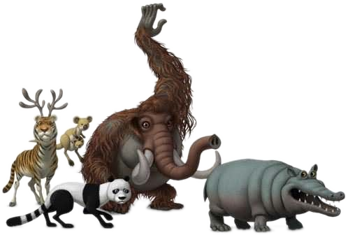
Polymorphism
Live Demo
Notes:
(c) 2006 National Academy for Software Development - http://academy.devbg.org*
13##

Slide 14
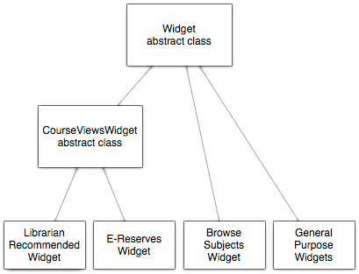
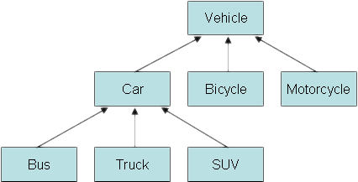
Class Hierarchies: Real World Example
Notes:
(c) 2006 National Academy for Software Development - http://academy.devbg.org*
14##

Slide 15
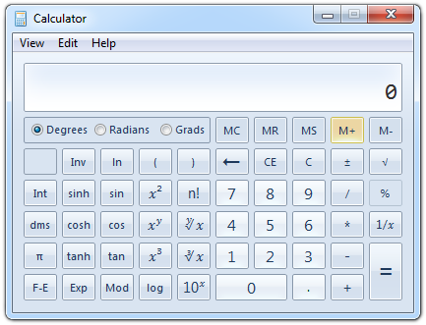
Real World Example: Calculator
Creating an application like the Windows Calculator
Typical scenario for applying the object-oriented approach
15

Slide 16
Real World Example: Calculator (2)
The calculator consists of controls:
Buttons, panels, text boxes, menus, check boxes, radio buttons, etc.
Class Control – the root of our OO hierarchy
All controls can be painted on the screen
Should implement an interface IPaintable with a method Paint()
Common properties: location, size, text, face color, font, background color, etc.
16

Slide 17
Real World Example: Calculator (3)
Some controls could contain other (nested) controls inside (e. g. panels and toolbars)
We should have class Container that extends Control holding a collection of child controls
The Calculator itself is a Form
Form is a special kind of Container
Contains also border, title (text derived from Control), icon and system buttons
How the Calculator paints itself?
Invokes Paint() for all child controls inside it
17

Slide 18
Real World Example: Calculator (4)
How a Container paints itself?
Invokes Paint() for all controls inside it
Each control knows how to visualize itself
What is the common between buttons, check boxes and radio buttons?
Can be pressed
Can be selected
We can define class AbstractButton and all buttons can derive from it
18

Slide 19
Calculator Classes
«interface»
IPaintable
Paint()
Control
-location
-size
-text
-bgColor
-faceColor
-font
Container
AbstractButton
TextBox
MainMenu
MenuItem
Panel
Form
Button
CheckBox
RadioButton
Calculator
19

Slide 20
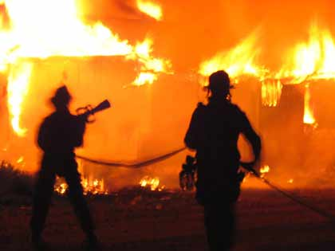
Exception Classes
User-Defined Exception Classes

Slide 21
Exception Handling in OOP
In OOP exception handling is the main paradigm for error handling
Exceptions are special classes that hold information about an error or unusual situation
Exceptions are thrown (raised) through the throw keyword
Exceptions are handled though the try-catch-finally and using(…) constructs
throw new InvalidCalculationException(
"Cannot calculate the size of the specified object");

Slide 22
Exception Hierarchy
Exceptions in .NET Framework are organized in a object-oriented class hierarchy

Slide 23
Defining an Exception Class
To define an exception class, inherit from ApplicationException and define constructors
using System;
public class InvalidCalculationException
: ApplicationException
{
public InvalidCalculationException(string msg)
: base(msg)
{ }
public InvalidCalculationException(string msg,
Exception innerEx) : base(msg, innerEx)
{ }
}

Slide 24

Defining Exception Classes
Live Demo

Slide 25
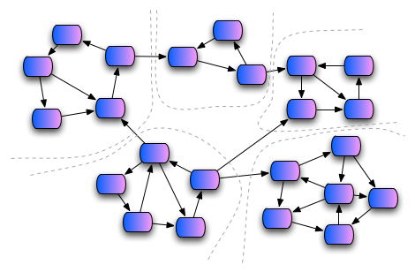
Cohesion and Coupling

Slide 26
Cohesion
Cohesion describes
How closely the routines in a class or the code in a routine support a central purpose
Cohesion must be strong
Well-defined abstractions keep cohesion strong
Classes must contain strongly related functionality and aim for single purpose
Cohesion is a powerful tool for managing complexity

Slide 27



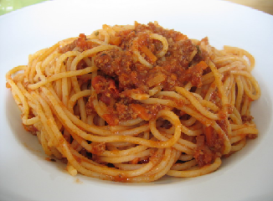
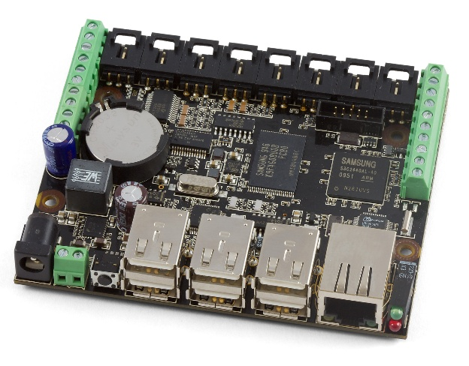
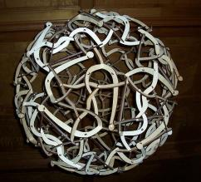
Good and Bad Cohesion
Good cohesion: HDD, CR-ROM, remote control
Bad cohesion: spaghetti code, single-board computer

Slide 28
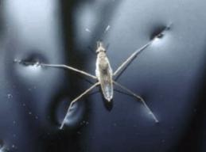
Strong Cohesion
Strong cohesion (good cohesion) example
Class Math that has methods:
Sin(), Cos(), Asin()
Sqrt(), Pow(), Exp()
Math.PI, Math.E
double sideA = 40, sideB = 69;
double angleAB = Math.PI / 3;
double sideC =
Math.Pow(sideA, 2) + Math.Pow(sideB, 2)
- 2 * sideA * sideB * Math.Cos(angleAB);
double sidesSqrtSum = Math.Sqrt(sideA) + Math.Sqrt(sideB) + Math.Sqrt(sideC);

Slide 29
Weak Cohesion
Weak cohesion (bad cohesion) example
Class Magic that has these methods:
Another example:
public void PrintDocument(Document d);
public void SendEmail(
string recipient, string subject, string text);
public void CalculateDistanceBetweenPoints(
int x1, int y1, int x2, int y2)
MagicClass.MakePizza("Fat Pepperoni");
MagicClass.WithdrawMoney("999e6");
MagicClass.OpenDBConnection();

Slide 30
Coupling
Coupling describes how tightly a class or routine is related to other classes or routines
Coupling must be kept loose
Modules must depend little on each other
Or be entirely independent (loosely coupled)
All classes / routines must have small, direct, visible, and flexible relationships to other classes / routines
One module must be easily used by other modules

Slide 31
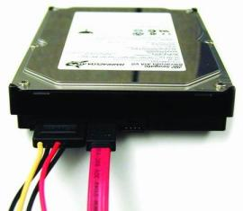
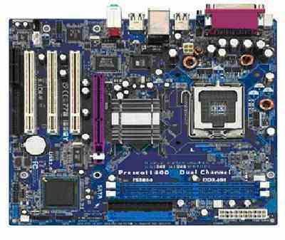
Loose and Tight Coupling
Loose Coupling:
Easily replace old HDD
Easily place this HDD to another motherboard
Tight Coupling:
Where is the video adapter?
Can you change the video controller?

Slide 32
Loose Coupling – Example
class Report
{
public bool LoadFromFile(string fileName) {…}
public bool SaveToFile(string fileName) {…}
}
class Printer
{
public static int Print(Report report) {…}
}
class Program
{
static void Main()
{
Report myReport = new Report();
myReport.LoadFromFile("C:\\DailyReport.rep");
Printer.Print(myReport);
}
}

Slide 33
Tight Coupling – Example
class MathParams
{
public static double operand;
public static double result;
}
class MathUtil
{
public static void Sqrt()
{
MathParams.result = CalcSqrt(MathParams.operand);
}
}
class MainClass
{
static void Main()
{
MathParams.operand = 64;
MathUtil.Sqrt();
Console.WriteLine(MathParams.result);
}
}

Slide 34
Spaghetti Code
Combination of bad cohesion and tight coupling:
class Report
{
public void Print() {…}
public void InitPrinter() {…}
public void LoadPrinterDriver(string fileName) {…}
public bool SaveReport(string fileName) {…}
public void SetPrinter(string printer) {…}
}
class Printer
{
public void SetFileName() {…}
public static bool LoadReport() {…}
public static bool CheckReport() {…}
}

Slide 35
Summary
OOP fundamental principals are: inheritance, encapsulation, abstraction, polymorphism
Inheritance allows inheriting members from another class
Abstraction and encapsulation hide internal data and allow working through abstract interface
Polymorphism allows working with objects through their parent interface and invoke abstract actions
Exception classes are natural to OOP
Strong cohesion and loose coupling avoid spaghetti code

Slide 36


Object-Oriented Programming Fundamental Principles – Part II
Questions?
http://academy.telerik.com

Slide 37
Exercises
Define abstract class Shape with only one abstract method CalculateSurface() and fields width and height. Define two new classes Triangle and Rectangle that implement the virtual method and return the surface of the figure (height*width for rectangle and height*width/2 for triangle). Define class Circle and suitable constructor so that at initialization height must be kept equal to width and implement the CalculateSurface() method. Write a program that tests the behavior of the CalculateSurface() method for different shapes (Circle, Rectangle, Triangle) stored in an array.
37

Slide 38
Exercises (2)
A bank holds different types of accounts for its customers: deposit accounts, loan accounts and mortgage accounts. Customers could be individuals or companies.
All accounts have customer, balance and interest rate (monthly based). Deposit accounts are allowed to deposit and with draw money. Loan and mortgage accounts can only deposit money.
All accounts can calculate their interest amount for a given period (in months). In the common case its is calculated as follows: number_of_months * interest_rate.

Slide 39
Exercises (3)
Loan accounts have no interest for the first 3 months if are held by individuals and for the first 2 months if are held by a company.
Deposit accounts have no interest if their balance is positive and less than 1000.
Mortgage accounts have ½ interest for the first 12 months for companies and no interest for the first 6 months for individuals.
Your task is to write a program to model the bank system by classes and interfaces. You should identify the classes, interfaces, base classes and abstract actions and implement the calculation of the interest functionality through overridden methods.

Slide 40
Exercises (4)
Define a class InvalidRangeException<T> that holds information about an error condition related to invalid range. It should hold error message and a range definition [start … end].
Write a sample application that demonstrates the InvalidRangeException<int> and InvalidRangeException<DateTime> by entering numbers in the range [1..100] and dates in the range [1.1.1980 … 31.12.2013].

Slide 41
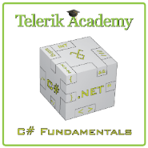



Free Trainings @ Telerik Academy
C# Programming @ Telerik Academy
csharpfundamentals.telerik.com
Telerik Software Academy
academy.telerik.com
Telerik Academy @ Facebook
facebook.com/TelerikAcademy
Telerik Software Academy Forums
forums.academy.telerik.com

